Slide 1
Problem Statement- Secure HIPAA-Compliant Medical Record Exchange Platform
Vishesh Varshney - 229301689
Theme –Privacy Focused Webapp

Slide 2
Explanation of problem statement
The Challenge:
In healthcare, securely sharing medical records between patients and providers is essential but faces critical challenges:
Data Privacy Risks: Unauthorized access and frequent data breaches.
Compliance Complexity: Strict HIPAA standards for safeguarding patient information.
Lack of Robust Platforms: Existing solutions often lack encryption, audit logging, and access control.
The Need:
A secure, privacy-focused web application that ensures:
End-to-end encryption for data protection.
Role-based access control to limit unauthorized access.
Detailed audit logs for transparency and compliance.
Goal:
Build a user-friendly platform that adheres to HIPAA standards while enabling seamless

Slide 3
Solution of Problem Statement
Our Solution:
Develop a privacy-focused web application that ensures secure and seamless sharing of medical documents between patients and healthcare professionals. The platform will address the challenges of data privacy, compliance, and security by implementing the following features:
Key Features:
End-to-End Encryption: Ensures all medical records are encrypted during storage and transmission to prevent unauthorized access.
Role-Based Access Control (RBAC): Restricts access to sensitive data based on user roles (e.g., patient, doctor, admin), ensuring the principle of least privilege.
Detailed Audit Logging: Tracks all activities (access, modifications, downloads) for transparency and compliance with HIPAA standards.
4. User-Friendly Interface: Provides an intuitive design for easy navigation by patients and healthcare providers.
Technical Architecture:
Frontend: A responsive web interface for users to upload, share, and view medical records securely.
Backend: A robust server with encryption algorithms, secure APIs, and database management adhering to HIPAA standards.

Slide 4
Unique Selling Point (USP)
A cutting-edge web application that combines security, compliance, and usability to revolutionize medical document sharing.
What Sets Us Apart:
End-to-End Encryption: Ensures complete protection of medical records during storage and transmission.
Role-Based Access Control (RBAC): Provides granular control over data access, adhering to the principle of least privilege.
Detailed Audit Logging: Tracks every interaction with medical records for transparency and compliance verification.
User-Friendly Interface: Simplifies secure file sharing for both patients and healthcare professionals, making compliance effortless.
Why It’s Unique:
Unlike existing solutions, our platform seamlessly integrates robust security features with HIPAA compliance while maintaining ease of use, empowering healthcare providers to share sensitive data securely without sacrificing efficiency.

Slide 5
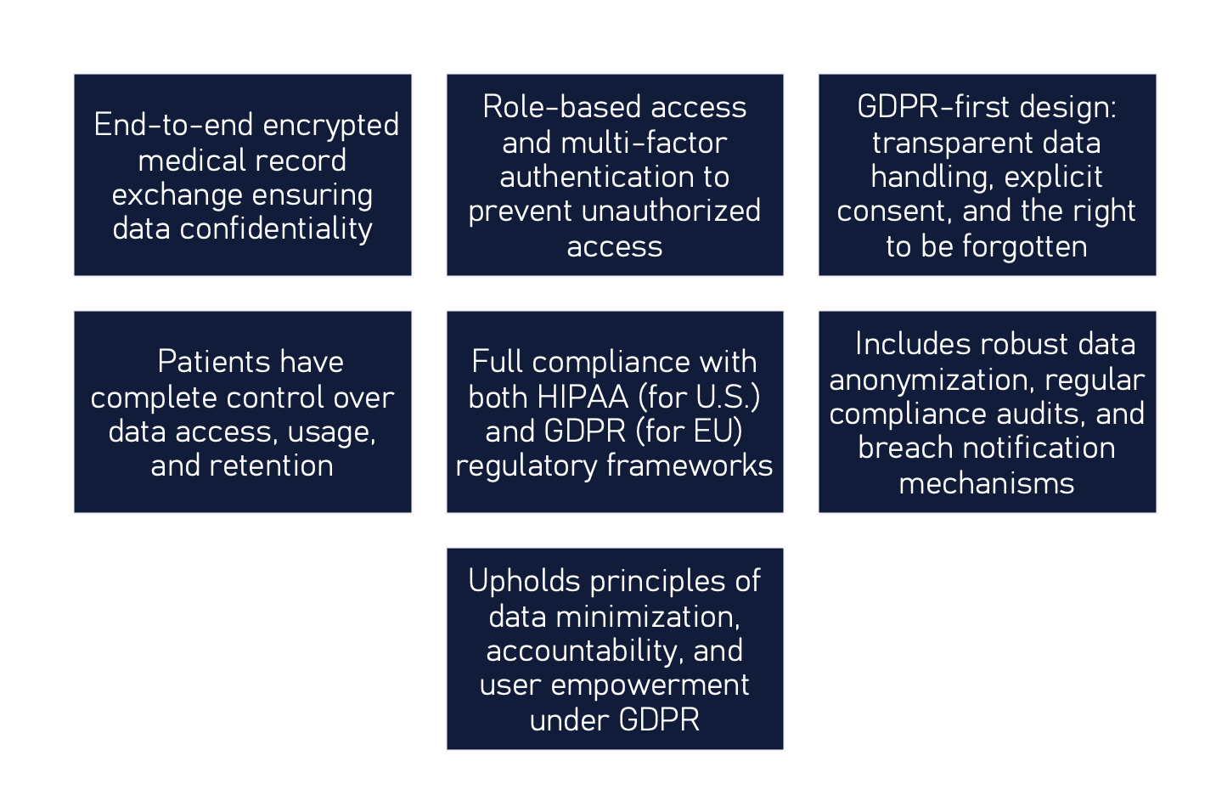
Maximum Privacy and Security with Strong Maximum Privacy and Security with Strong HIPPA-Centric Compliance-Centric Compliance

Slide 6


Implementing RBAC for Medical Security
Doctor Role
Doctors have access to patient medical records necessary for treatment while ensuring confidentiality and compliance with regulations.
Patient Role
Patients can view their own medical records, ensuring transparency and empowering them in their healthcare decisions.
Hospital Admin Role
Hospital administrators have master access to all records, enabling management of data access and security protocols.

Slide 7
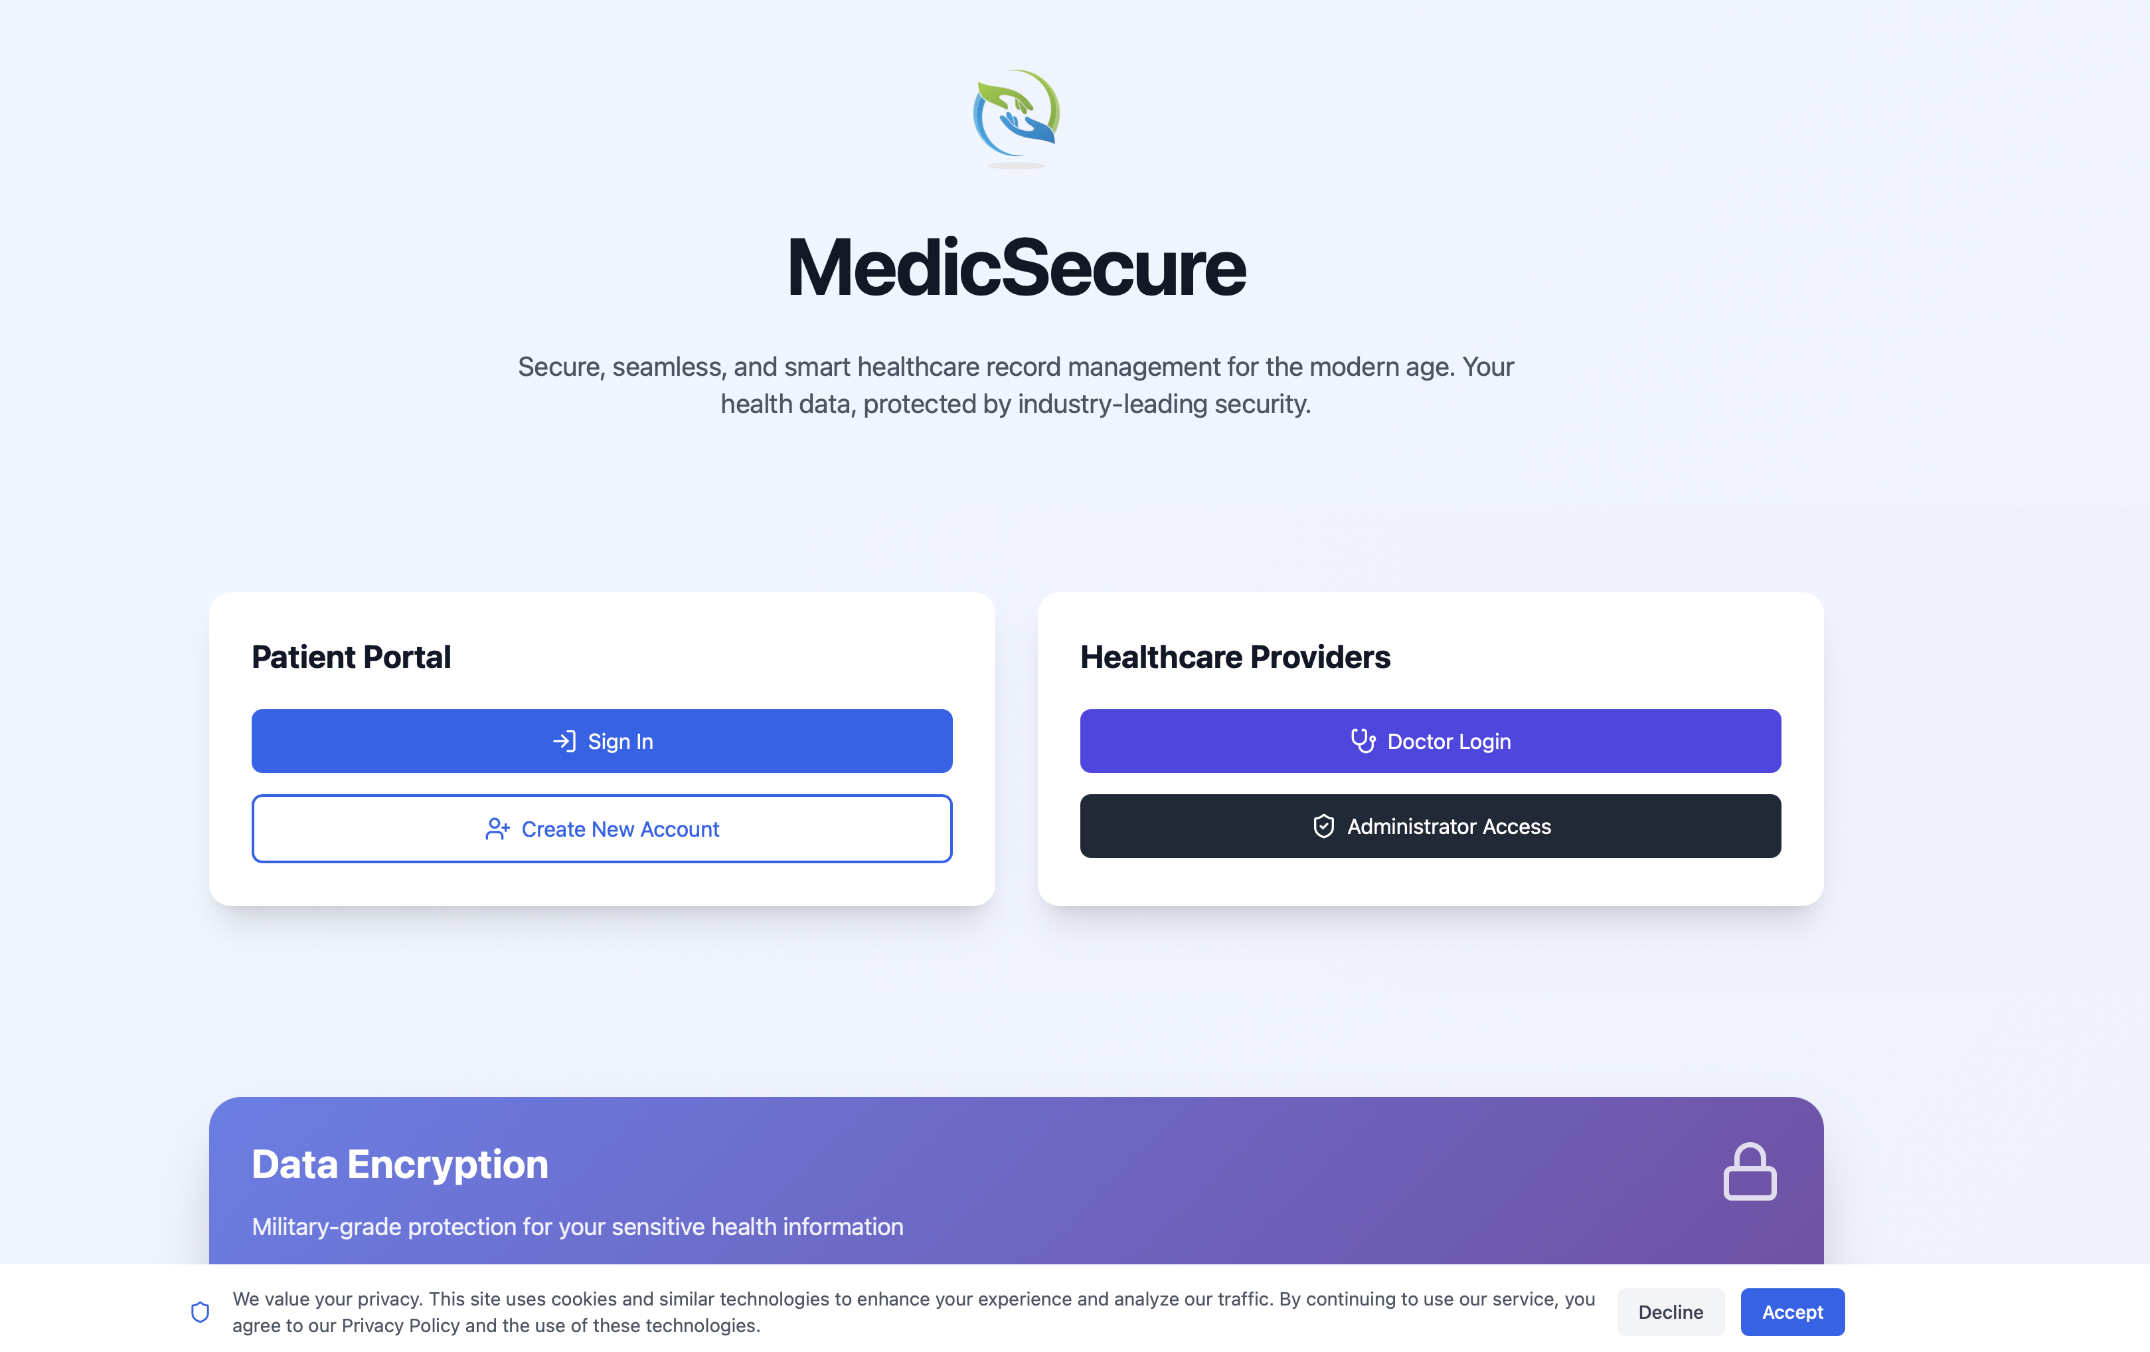
Responsive Frontend Implementation
Link: https://medicsecure.netlify.app/

Slide 8
Comprehensive Technology Stack Overview
﻿﻿Frontend Development Technologies:
Utilizing Vite, TypeScript, and React for a dynamic frontend experience.
﻿﻿Secure Data Storage:
PostgreSQL ensures robust and secure storage of sensitive data.
﻿﻿Ul Consistency with Tailwind CSS:
Tailwind CSS provides a unified approach to styling, enhancing Ul consistency.
Secure Data Transfer:
Python was used for the implementation of AES-256, an encryption algorithm for secure file transferring.

Slide 9
Comprehensive Security Measures Overview
Overview of HIPAA-Compliant Security Practices:
TLS and SSL for Secure Website Protection Utilizes TLS 1.2 and SSL protocols to ensure secure encryption of data during transit via HTTPS, safeguarding sensitive information from eavesdropping and unauthorized access.
AES 256 File Encryption
Implements AES 256 encryption standard for files, providing a high level of security against unauthorized access to stored data.
Session-Based Access Control
Employs JWT for session-based access control, allowing secure authentication and authorization of users in the system.
End-to-End Encryption
Ensures that data is encrypted on the sender's side and only decrypted on the receiver's side, maintaining confidentiality throughout the exchange.
Supabase as Authentication Provider
Utilizes Supabase for user authentication, streamlining secure access management and user data protection.

Slide 10
Thank You
Team – Bit by Bit
Members- Vishesh Varshney (229301689)
Pranav Anand (229310373)
Arnav Gupta (229310451)

